Slide 1
Work Experience 2026
PART 1
Ash Green School
CEIAG

Slide 2

Today- Part 1
What is work experience & why?
Expectations
Support
Other Key Information
Next Steps

Slide 3

What is Work Experience?
A short-term placement where a student temporarily works for an employer to gain knowledge and skills relevant to a job role/profession.
1 week
For the hours usually undertaken by a permanent employee e.g., 8am-4pm or 9am-5pm or 6:30am-3:30pm
Ideally related to your chosen Career - if known

Slide 4
Monday 27th April
–
Friday 1st May 2026
Dates:

Slide 5
Why?
31% of young people said work experience improved their confidence and self-belief, rising to 55% among older age groups (CDI)
Young people are three times more likely to be unemployed than the rest of the population.
(Careers and Enterprise Company)
Work experience reduces the likelihood of being NEET (Not in Education, Employment or Training) from 11% to 7% (CDI)
A YouGov poll of 2,000 young adults found that:
Those who completed work experience reported a 3.4% higher average wage, equivalent to £1,088 more per year based on a £32k salary.

Slide 6

Work Experience Offers…
Opportunity to test a career idea- before committing to courses/training.
A chance to engage & interact with people outside of your normal remit- we all have to do this!
Something to write on your CV & support future course/apprenticeship applications- this could make all the difference.
Experience of the working world.
Make connections for future employment/support.
Potential reference.
A chance to be independent & take responsibility.

Slide 7
What is expected of students?
Work Experience 2026

Slide 8

What you will need to do …
You will be expected to find & secure a placement.
  This will involve contacting local employers and enquiring about opportunities.
Once the employer has agreed to host you:
  You will need to gather key information.
  Submit these details on the placements tool (Unifrog)- more guidance in the next presentation

Slide 9


Support Available
To help, you will receive the following support:
Student guides- detailing all the key information needed.
Tutor activities- containing hints & tips
Access to Unifrog- a universal careers platform containing a wealth of information and guidance.
Database of employers who have hosted students before.
Parent information session- (pre-recorded presentation).

Slide 10

The work experience process
Generate career ideas & professions of interest- use Unifrog to help.
Related to your career interests, create a list of local employers
Actively enquire about work experience with employers
Verbally secure a placement & gather relevant information
Complete & submit the ‘student form’ on Unifrog (Placement tool)
Placement vetting occurs
Notification of approval
Undertake the placement
Review the placement
The student pack contains further guidance

Slide 11

What is Unifrog?
You all have an account already!
Linked to your student email
(Your computer login handle, @ the school domain)
e.g. ags-20abcd@ashgreenschool.org.uk
Unifrog is a comprehensive platform where students can easily explore their career interests; find careers-related
information and successfully apply for their next steps after school.

Slide 12
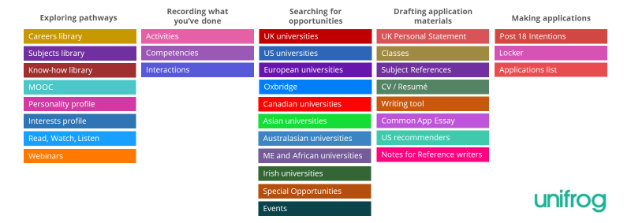
Unifrog Tools
Unifrog has a vast array of ‘tools’ related to careers education. Your account will have access to most of these, so use them!
You can favourite and store information, keeping everything in one place.
Placements

Slide 13

What Makes a Good Placement?
Involves a range of tasks and/or departments.
Outside of normal experiences- not continuing your current work/activities.
When you actively engage in this process and seize the opportunity.
Allows you to test a career idea
All placements will give you an experience of the working environment and develop general employability skills.
This experience mimics the recruitment process.

Slide 14

The Challenges
Finding a placement can be difficult.
Students should expect:
‘No' a lot – often mentioning insurance!
Contacting 20+ employers
Not receiving responses to enquiries or long delays in responses.
Contact multiple organisations- don’t wait for a response before contacting another employer.

Slide 15

No placement!- In school, as normal, with a planned programme.
Do NOT approach other school staff for placements at AGS- You need to experience other environments.
Placement partially closed during the school week? - in school these days.
Logbook to complete during the placement.
Staff will ‘check in’ with the employer & you during the placement.
Eligible for free school meals? - You can collect a packed lunch from the school reception at the beginning of each day. Please speak to Mrs Mahloudji about this.

Slide 16
What Next?
Start exploring job roles of interest. Utilise Unifrog
Engage in tutor activities
Generate work experience ideas
Research local employers. Record their contact details
Work Experience 2026- Part 1
Draft an enquiry email & practice phone conversations (see student pack part 1 for support)
Contact employers

Slide 17
Work Experience 2026- Timeline
As soon as you have a placement secured, complete the placement tool (Unifrog).
October 2025 | · Student/Parent Launch · Student support packs- Part 1 issued · Start to conduct your research- Identify career sectors of interest and local companies
November 2025 | · Actively contacting employers & making enquiries- Use the support pack for examples of emails & phone conversations. · Tutor support activities · Student Support Packs- Part 2 issued, with assembly on the vetting process.
30th January 2026 | Secured a placement and submitted the details on Unifrog, (Placement tool) – this triggers health & safety checks to start.
On-going notification of placement approval—Via Email/Unifrog
W/B 13th April 2026 | Contact the placement provider again to remind them you will be joining soon. Double-check key information to ensure it has not changed, e.g. start/finish times, arrival on the first day, dress code, lunch arrangements, etc.
W/B 27th April 2026 | Undertake placement & Complete logbook.
W/B 4th May 2026 | Review placement and update your CV.

Slide 18
Any Questions?
Work Experience 2026- Part 1

Slide 19
Placement Vetting
Student Form
Once a student secures a placement, they must complete and submit the Unifrog placement tool. Unifrog then automatically contacts the employer, (using the employer email on the student form- make sure it is accurate). Information in the student form is shared with the employer, so detail any medical issues or additional needs.
Employer Form
The employer receives a link to Unifrog and completes their own form. This includes key questions about the placement, their health & safety practices, insurance and risk assessments. Once submitted parents/carers are notified.
Parent / Carer Form
Parents/carers review all the information (student & employer forms) and consent to participation. They can add any further details if needed.
Placement Coordinator Review
The schools work experience coordinator reviews all answers from each form and decides if the placement is approved. If approved, the student, parent and employer will be automatically notified, by email. The placement can then occur. Occasionally, an answer may generate further enquiry. The placement coordinator will contact the various people to clarify any issues, before hopefully approving the placement.

