Slide 1


Year 10 Work Experience 2026

Slide 2

What is Work Experience?
A short-term placement where a student temporarily works for an employer to gain knowledge and skills relevant to a job role/profession.
1 week
For the hours usually undertaken by a permanent employee e.g., 8am-4pm or 9am-5pm or 6:30am-3:30pm
Ideally related to your chosen Career - if known

Slide 3
Monday 27th April
–
Friday 1st May 2026
Dates:

Slide 4
Why?
31% of young people said work experience improved their confidence and self-belief, rising to 55% among older age groups (CDI)
Young people are three times more likely to be unemployed than the rest of the population.
(Careers and Enterprise Company)
Work experience reduces the likelihood of being NEET (Not in Education, Employment or Training) from 11% to 7% (CDI)
A YouGov poll of 2,000 young adults found that:
Those who completed work experience reported a 3.4% higher average wage, equivalent to £1,088 more per year based on a £32k salary.

Slide 5

Work Experience Offers…
Opportunity to test a career idea- before committing to courses/training.
A chance to engage & interact with people outside of your normal remit- we all have to do this!
Something to write on your CV & support future course/apprenticeship applications- this could make all the difference.
Experience of the working world.
Make connections for future employment/support.
Potential reference.
A chance to be independent & take responsibility.

Slide 6
What is expected of students?
Work Experience 2026

Slide 7

What students will need to do …
Students will be expected to find & secure a placement.
  This will involve contacting local employers and enquiring about opportunities.
Once the employer has agreed to host you:
  You will need to gather key information.
  Submit these details on the placements tool (Unifrog)- more guidance in the next presentation

Slide 8
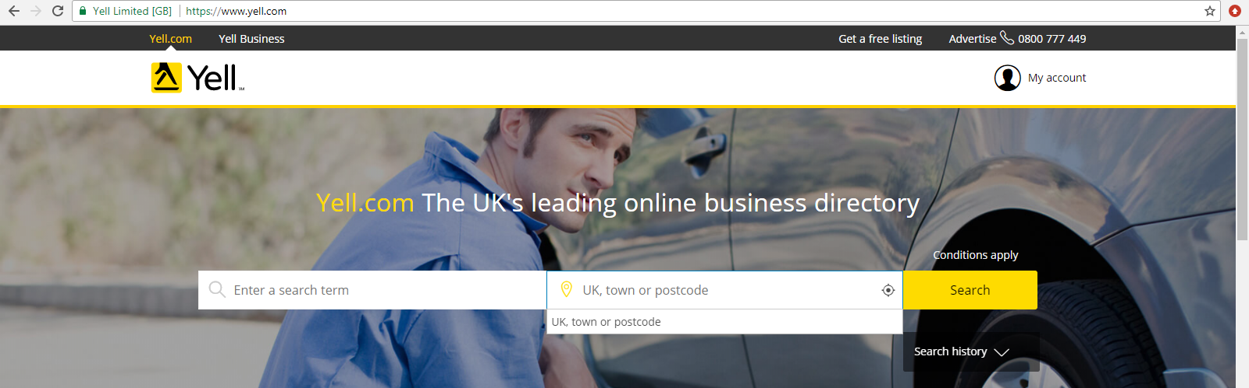
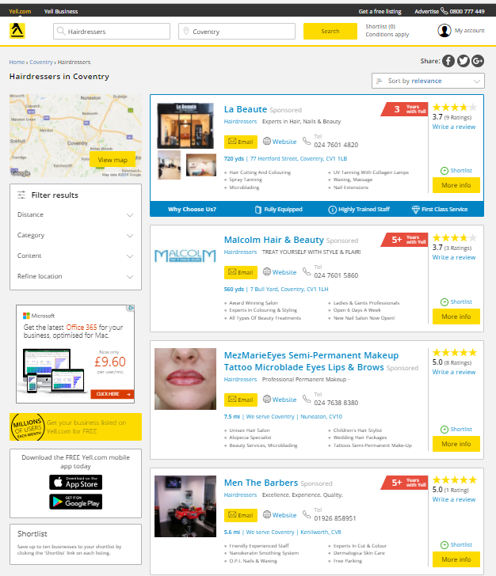
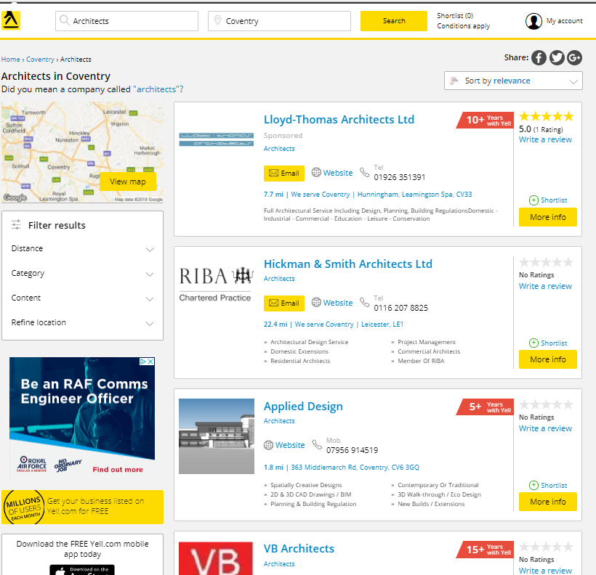
How to find local employers
www.yell.com
www.thomsonlocal.com
Directories will give you all the contact details you need.
Use them to make a list local employers & start contacting them.
Remember to- Introduce yourself, state why you are contacting them, ask to speak to the relevant person, and give them the dates.
See your student booklet for support with making contact

Slide 9
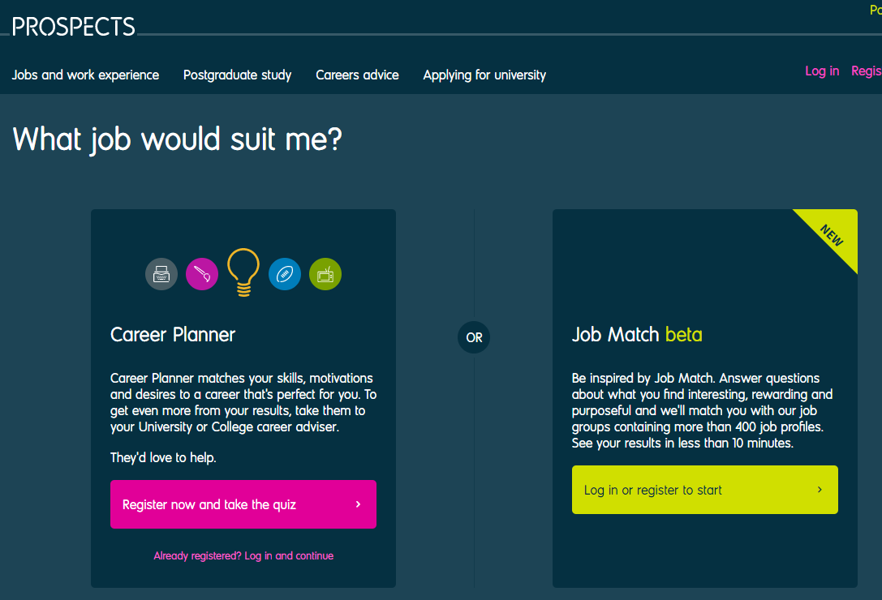
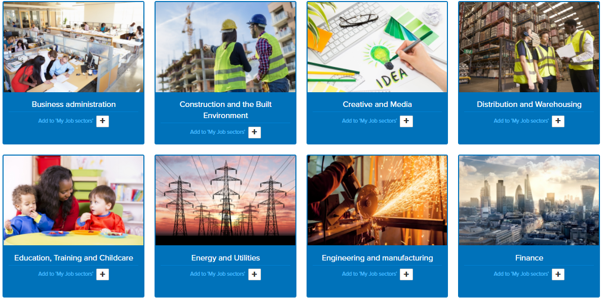
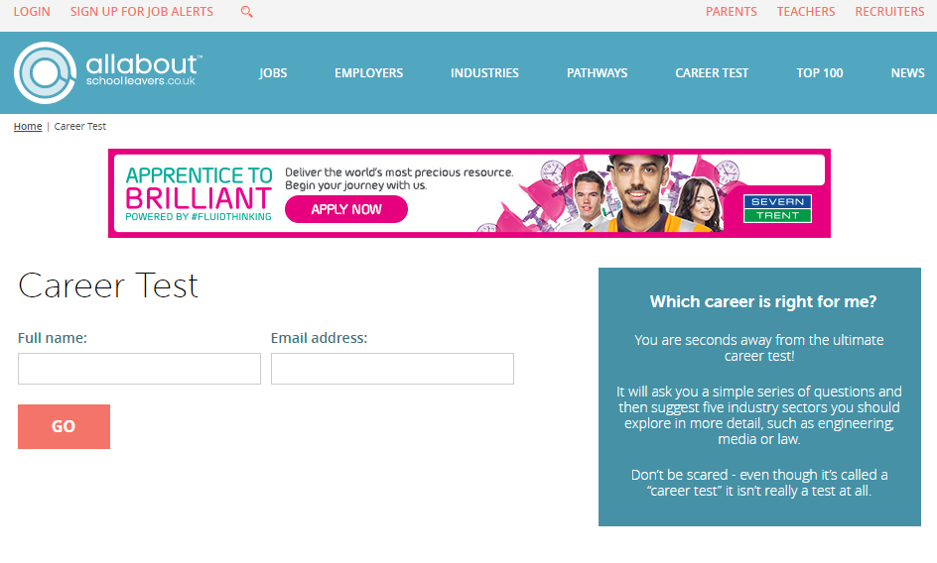
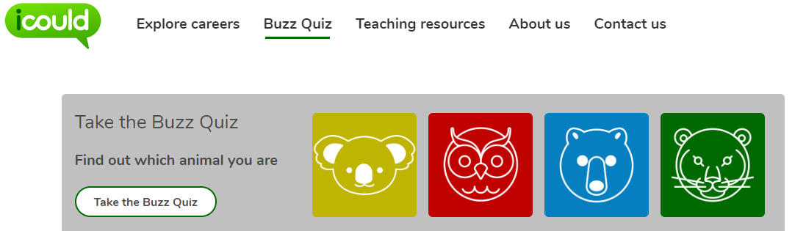
NO IDEAs?
No idea what you want to do? Try the following:
Start with interests e.g. sport, music, reading, drawing
  Mind map/research careers in this field
Use some of the career matching tests- See your student packs
Review Career Websites for a description of various job sectors- See student pack
Alternatively, decide what do you definitely not want to do and look for any opportunities that avoid this.
Use the information gathered to identify a few careers of interest or a job sector to try for work experience. Now use the previous websites to search for local employers in these areas.

Slide 10


Support Available
To help, you will receive the following support:
Student guides- detailing all the key information needed.
Tutor activities- containing hints & tips.
Mrs Mahloudji (careers advisor)
Access to Unifrog- a universal careers platform containing a wealth of information and guidance.
Database of employers who have hosted students before.
Parent information session

Slide 11

What Makes a Good Placement?
Involves a range of tasks and/or departments.
Outside of normal experiences- not continuing your current work/activities.
When you actively engage in this process and seize the opportunity.
Allows you to test a career idea
All placements will give you an experience of the working environment and develop general employability skills.
This experience mimics the recruitment process.

Slide 12
Where can students undertake a placement?
The employer will need to provide the following information to us:
Evidence of Employer Liability Insurance (Copy of a certificate of insurance and policy number)
Health and safety policy (employers with 5+ employees will have this) or risk assessment
In the UK these sorts of employers are exempt from needing Employers' Liability Insurance:
Sole traders, and companies employing only their owner where that employee also owns 50% or more of the issued share capital in the company;
Most public organisations including government departments and agencies, local authorities, police authorities and nationalised industries;
Health service bodies, including National Health Service trusts, health authorities, primary care trusts and Scottish health boards;
Some other organisations which are financed through public funds, such as passenger transport executives and magistrates’ courts committees;
Family businesses, i.e. if all of your employees are closely related to you (as husband, wife, civil partner, father, mother, grandfather, grandmother, stepfather, stepmother, son, daughter, grandson, granddaughter, stepson, stepdaughter, brother, sister, half-brother or half-sister). However, this exemption does not apply to family businesses which are incorporated as limited companies.

Slide 13

The Challenges
Finding a placement can be difficult.
Students should expect:
‘No' a lot – often mentioning insurance!
Contacting 20+ employers
Not receiving responses to enquiries or long delays in responses.
Contact multiple organisations- don’t wait for a response before contacting another employer.

Slide 14

No placement!- In school, as normal, with a planned programme.
Do NOT approach other school staff for placements at AGS- You need to experience other environments.
Placement partially closed during the school week? - in school these days.
Logbook to complete during the placement.
Staff will ‘check in’ with the employer & you during the placement.
Eligible for free school meals? - You can collect a packed lunch from the school reception at the beginning of each day. Please speak to Mrs Mahloudji about this.

Slide 15

The work experience process
Generate career ideas & professions of interest- use Unifrog to help.
Related to your career interests, create a list of local employers
Actively enquire about work experience with employers
Verbally secure a placement & gather relevant information
Complete & submit the ‘student form’ on Unifrog (Placement tool)
Placement vetting occurs
Notification of approval
Undertake the placement
Review the placement
The student pack contains further guidance

Slide 16

What is Unifrog?
You all have an account already!
Linked to your student email
(Your computer login handle, @ the school domain)
e.g. ags-20abcd@ashgreenschool.org.uk
Unifrog is a comprehensive platform where students can easily explore their career interests; find careers-related
information and successfully apply for their next steps after school.

Slide 17
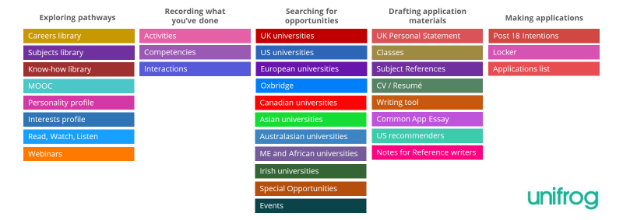
Unifrog Tools
Unifrog has a vast array of ‘tools’ related to careers education. Your account will have access to most of these, so use them!
You can favourite and store information, keeping everything in one place.
Placements

Slide 18
What Next?
Start exploring job roles of interest. Utilise Unifrog
Engage in tutor activities
Generate work experience ideas
Research local employers. Record their contact details
Work Experience 2026
Draft an enquiry email & practice phone conversations (see student pack part 1 for support)
Contact employers

Slide 19

COULD YOU OFFER A PLACEMENT?
You may be an employer or work for an organisation that offers work experience placements.
If you think you could offer placements to any of our year 10 students, please do get in touch.
We would need the following information:
  Place of employment
  Type of employment
  Duties students would experience
  How to apply for the placement/ who to contact

Slide 20
Work Experience 2026- Timeline
As soon as you have a placement secured, complete the placement tool (Unifrog).
October 2025 | Student Launch Student support packs- Part 1 issued Start to conduct your research- Identify career sectors of interest and local companies
November 2025 | Parent Launch Actively contacting employers & making enquiries- Use the support pack for examples of emails & phone conversations. Tutor support activities Student Support Packs- Part 2 issued, with assembly on the vetting process. Students can begin to add placement details to Unifrog if secured
30th January 2026 | Secured a placement and submitted the details on Unifrog, (Placement tool) – this triggers health & safety checks to start.
February/ March On-going notification of placement approval (Employer and Parents)—Via Email/Unifrog
W/B 13th April 2026 | Contact the placement provider again to remind them you will be joining soon. Double-check key information to ensure it has not changed, e.g. start/finish times, arrival on the first day, dress code, lunch arrangements, etc.
W/B 27th April 2026 | Undertake placement & Complete logbook.
W/B 4th May 2026 | Review placement and update your CV.

Slide 21
Any Questions?
Work Experience 2026

